Slide 1
B⁺-Trees (Part 1)
COMP171

Slide 2
Main and secondary memories
Secondary storage device is much, much slower than the main RAM
Pages and blocks
Internal, external sorting
CPU operations
Disk access: Disk-read(), disk-write(), much more expensive than the operation unit

Slide 3

Contents
Why B⁺ Tree?
B⁺ Tree Introduction
Searching and Insertion in B⁺ Tree

Slide 4
Motivation
AVL tree with N nodes is an excellent data structure for searching, indexing, etc.
  The Big-Oh analysis shows most operations finishes within O(logN) time
The theoretical conclusion works as long as the entire structure can fit into the main memory
When the data size is too large and has to reside on disk, the performance of AVL tree may deteriorate rapidly

Slide 5
A Practical Example
A 500-MIPS machine, with 7200 RPM hard disk
  500 million instruction executions, and approximately 120 disk accesses each second (roughly, 500 000 faster!)
A database with 10,000,000 items, 256 bytes each (assume it doesn’t fit in memory)
The machine is shared by 20 users
Let’s calculate a typical searching time for 1 user
  A successful search need log 10000000 = 24 disk access, around 4 sec. This is way too slow!!
We want to reduce the number of disk access to a very small constant
Notes:
RPM revolutions per minute

Slide 6
From Binary to M-ary
Idea: allow a node in a tree to have many children
  Less disk access = less tree height = more branching
As branching increases, the depth decreases
An M-ary tree allows M-way branching
  Each internal node has at most M children
A complete M-ary tree has height that is roughly log_{M}N instead of log₂N
  if M = 20, then log₂₀ 2²⁰ < 5
  Thus, we can speedup the search significantly

Slide 7
M-ary Search Tree
Binary search tree has one key to decide which of the two branches to take
M-ary search tree needs M-1 keys to decide which branch to take
M-ary search tree should be balanced in some way too
  We don’t want an M-ary search tree to degenerate to a linked list, or even a binary search tree

Slide 8
B⁺ Tree
A B⁺-tree of order M (M>3) is an M-ary tree with the following properties:
  The data items are stored at leaves
  The root is either a leaf or has between two and M children
  Node:
    The (internal) node (non-leaf) stores up to M-1 keys (redundant) to guide the searching; key i represents the smallest key in subtree i+1
    All nodes (except the root) have between ⎡M/2⎤ and M children
  Leaf:
    A leaf has between ⎡L/2⎤ and L data items, for some L (usually L << M, but we will assume M=L in most examples)
    All leaves are at the same depth
Note there are various definitions of B-trees, but mostly in minor ways.
The above definition is one of the popular forms.
Notes:
|_x_| the floor of x, the greatest integer less than or equal to x
|-x-| the ceilling of x, the least integer greater than or equal to x

Slide 9
Keys in Internal Nodes
Which keys are stored at the internal nodes?
There are several ways to do it. Different books adopt different conventions.
We will adopt the following convention:
  key i in an internal node is the smallest key (redundant) in its i+1 subtree (i.e. right subtree of key i)
Even following this convention, there is no unique B⁺-tree for the same set of records.

Slide 10
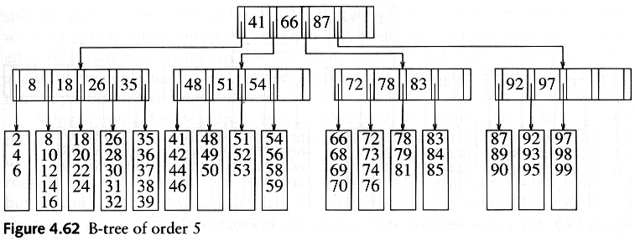
B⁺ Tree Example 1 (M=L=5)
Records are stored at the leaves (we only show the keys here)
Since L=5, each leaf has between 3 and 5 data items
Since M=5, each nonleaf nodes has between 3 to 5 children
Requiring nodes to be half full guarantees that the B+ tree does not degenerate into a simple binary tree

Slide 11
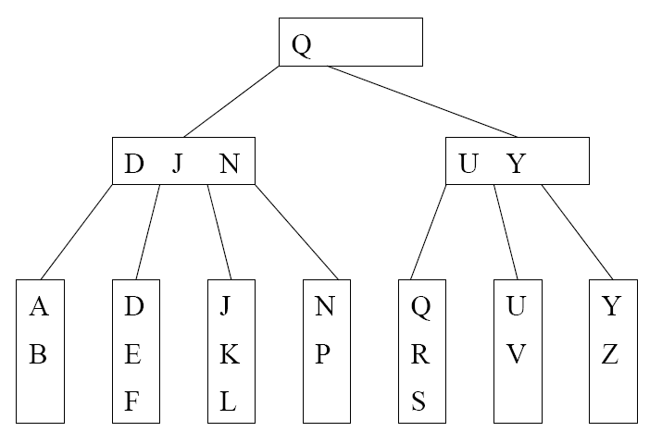
B⁺ Tree Example 2 (M=4, L=3)
We can still talk about left and right child pointers
E.g. the left child pointer of N is the same as the right child pointer of J
We can also talk about the left subtree and right subtree of a key in internal nodes

Slide 12
B+ Tree in Practical Usage
Each internal node/leaf is designed to fit into one I/O block of data. An I/O block usually can hold quite a lot of data. Hence, an internal node can keep a lot of keys, i.e., large M. This implies that the tree has only a few levels and only a few disk accesses can accomplish a search, insertion, or deletion.
B⁺-tree is a popular structure used in commercial databases. To further speed up the search, the first one or two levels of the B⁺-tree are usually kept in main memory.
The disadvantage of B⁺-tree is that most nodes will have less than M-1 keys most of the time. This could lead to severe space wastage. Thus, it is not a good dictionary structure for data in main memory.
The textbook calls the tree B-tree instead of B⁺-tree. In some other textbooks, B-tree refers to the variant where the actual records are kept at internal nodes as well as the leaves. Such a scheme is not practical. Keeping actual records at the internal nodes will limit the number of keys stored there, and thus increasing the number of tree levels.

Slide 13
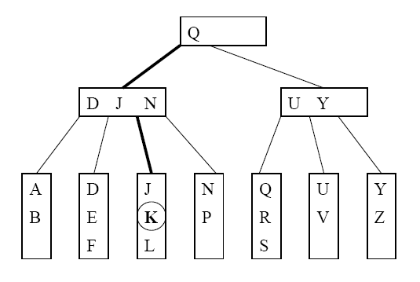
Searching Example
Suppose that we want to search for the key K. The path traversed is shown in bold.

Slide 14
Searching Algorithm
Let x be the input search key.
Start the searching at the root
If we encounter an internal node v, search (linear search or binary search) for x among the keys stored at v
  If x < K_{min} at v, follow the left child pointer of K_{min}
  If K_{i} ≤ x < K_{i+1} for two consecutive keys K_{i} and K_{i+1} at v, follow the left child pointer of K_{i+1}
  If x ≥ K_{max} at v, follow the right child pointer of K_{max}
If we encounter a leaf v, we search (linear search or binary search) for x among the keys stored at v. If found, we return the entire record; otherwise, report not found.

Slide 15
Insertion Procedure
we want to insert a key K
Search for the key K using the search procedure
This leads to a leaf x
Insert K into x
  If x is not full, trivial,
  If so, troubles, need splitting to maintain the properties of B+ tree (instead of rotations in AVL trees)

Slide 16
Insertion into a Leaf
A: If leaf x contains < L keys, then insert K into x (at the correct position in node x)
D: If x is already full (i.e. containing L keys). Split x
  Cut x off from its parent
  Insert K into x, pretending x has space for K. Now x has L+1 keys.
  After inserting K, split x into 2 new leaves x_{L} and x_{R}, with x_{L} containing the ⎣(L+1)/2⎦ smallest keys, and x_{R} containing the remaining ⎡(L+1)/2⎤ keys. Let J be the minimum key in x_{R}
  Make a copy of J to be the parent of x_{L} and x_{R}, and insert the copy together with its child pointers into the old parent of x.

Slide 17
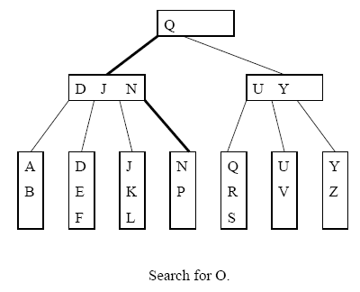
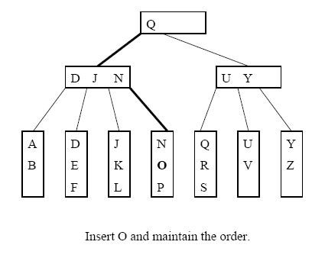
Inserting into a Non-full Leaf (L=3)

Slide 18
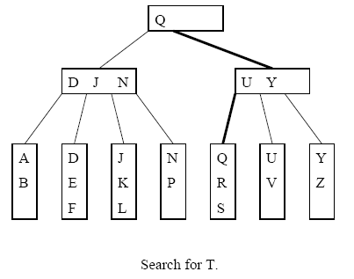
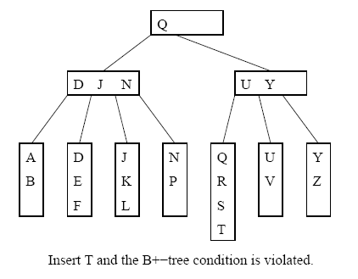
Splitting a Leaf: Inserting T

Slide 19
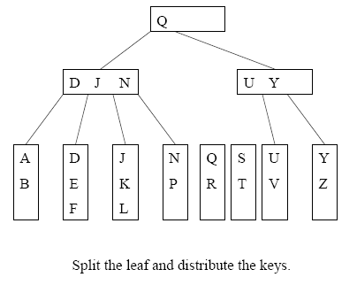
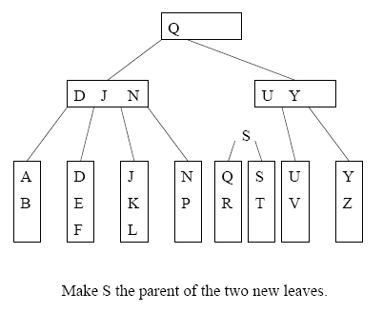
Splitting Example 1

Slide 20
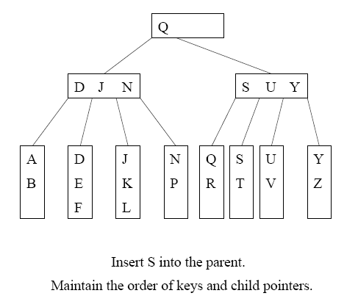
Two disk accesses to write the two leaves, one disk access to update the parent
For L=32, two leaves with 16 and 17 items are created. We can perform 15 more insertions without another split

Slide 21
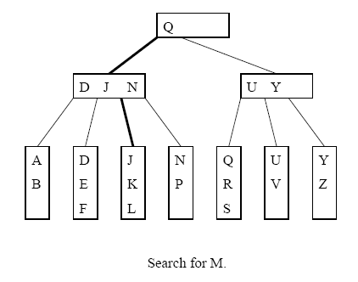
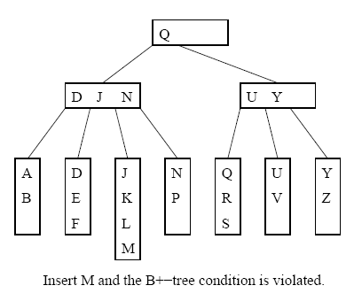
Splitting Example 2

Slide 22
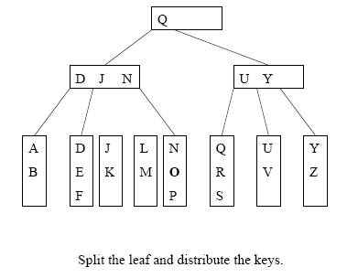
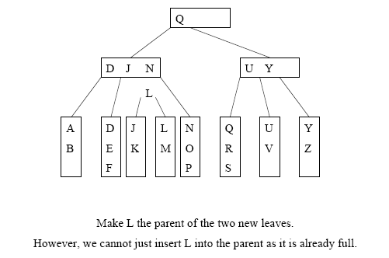
Cont’d
=> Need to split the internal node

Slide 23
E: Splitting an Internal Node
To insert a key K into a full internal node x:
Cut x off from its parent
Insert K as usual by pretending there is space
  Now x has M keys! Not M-1 keys.
Split x into 3 new internal nodes x_{L}and x_{R}, and x-parent!
  x_{L} containing the ( ⎡M/2⎤ - 1 ) smallest keys,
  and x_{R} containing the ⎣M/2⎦ largest keys.
  Note that the (⎡M/2⎤)th key J is a new node, not placed in x_{L} or x_{R}
Make J the parent node of x_{L} and x_{R}, and insert J together with its child pointers into the old parent of x.

Slide 24
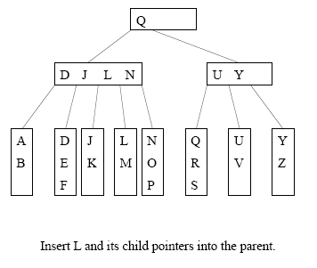
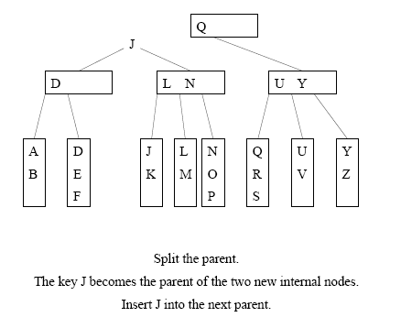
Example: Splitting Internal Node (M=4)
3+1 = 4, and 4 is split into 1, 1 and 2.
So D J L N is into D and J and L N

Slide 25
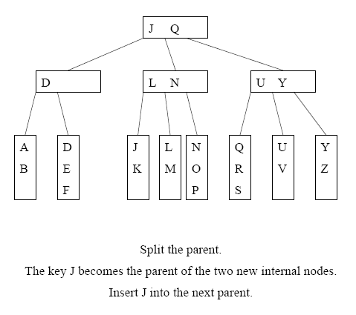
Cont’d

Slide 26
Termination
Splitting will continue as long as we encounter full internal nodes
If the split internal node x does not have a parent (i.e. x is a root), then create a new root containing the key J and its two children

Slide 27
Summary of B+ Tree of order M and of leaf size L
  The root is either a leaf or 2 to M children
  Each (internal) node (except the root) has between ⎡M/2⎤ and M children (at most M chidren, so at most M-1 keys)
  Each leaf has between ⎡L/2⎤ and L keys and corresponding data items
  We assume M=L in most examples.

Slide 28
Roadmap of insertion
Main conern: leaf and node might be full!
insert a key K
Search for the key K and get to a leaf x
Insert K into x
  If x is not full, trivial,
  If full, troubles ☹,
    need splitting to maintain the properties of B+ tree (instead of rotations in AVL trees)
A: Trivial (leaf is not full)
B: Leaf is full
  C: Split a leaf,
    D: trivial (node is not full)
    E: node is full → Split a node

